Slide 1
DEFORMABLE DETR: DEFORMABLE TRANSFORMERS FOR END-TO-END OBJECT DETECTION
Xizhou Zhu1∗, Weijie Su2∗ ‡, Lewei Lu1, Bin Li2, Xiaogang Wang1,3, Jifeng Dai1†
1SenseTime Research
2University of Science and Technology of China
3The Chinese University of Hong Kong
ICLR2021

Slide 2
摘要
DETR has been recently proposed to eliminate the need for many hand-designed components in object detection while demonstrating good performance. However, it suffers from slow convergence and limited feature spatial resolution, due to the limitation of Transformer attention modules in processing image feature maps. To mitigate these issues, we proposed Deformable DETR, whose attention modules only attend to a small set of key sampling points around a reference. Deformable DETR can achieve better performance than DETR (especially on small objects) with 10× less training epochs. Extensive experiments on the COCO benchmark demonstrate the effectiveness of our approach.
最近，在对象检测中提出了基于数据的检测，以消除对许多手工设计的组件的需要，同时显示出良好的性能。然而，由于Transformer注意模块在处理图像特征映射时的局限性，导致收敛速度慢，特征空间分辨率有限。为了缓解这些问题，我们提出了可变形DETR，其注意模块只关注参考点周围的一小部分关键采样点。可变形的目标检测比目标检测在训练周期少10倍的情况下获得更好的性能(特别是在小目标上)。在COCO基准上的大量实验证明了我们方法的有效性。

Slide 3
DETR缺点
DETR has its own issues: (1) It requires much longer training epochs to converge than the existing object detectors. For example, on the COCO (Lin et al., 2014) benchmark, DETR needs 500 epochs to converge, which is around 10 to 20 times slower than Faster R-CNN (Ren et al., 2015). (2) DETR delivers relatively low performance at detecting small objects. Modern object detectors usually exploit multi-scale features, where small objects are detected from high-resolution feature maps. Meanwhile, high-resolution feature maps lead to unacceptable complexities for DETR. The above-mentioned issues can be mainly attributed to the deficit of Transformer components in processing image feature maps. At initialization, the attention modules cast nearly uniform attention weights to all the pixels in the feature maps. Long training epoches is necessary for the attention weights to be learned to focus on sparse meaningful locations. On the other hand, the attention weights computation in Transformer encoder is of quadratic computation w.r.t. pixel numbers. Thus, it is of very high computational and memory complexities to process high-resolution feature maps.
DETR有其自身的问题:
(1)与现有的目标检测器相比，它需要更长的训练时间来收敛。例如，在COCO 上，DETR需要500个epoch才能收敛，比fast R-CNN 慢10 - 20倍左右。
(2) DETR对于小目标的检测性能相对较低。现代物体探测器通常利用多尺度特征，小物体从高分辨率特征图中检测出来。与此同时，高分辨率的特征图也给数据提取带来了难以接受的复杂性。上述问题主要是由于Transformer组件在处理图像特征映射方面存在不足。在初始化时，注意模块对特征图中的所有像素施加几乎一致的注意权值。长时间的训练是学习注意权值集中于稀疏的有意义位置的必要条件。另一方面，Transformer encoder中注意权的计算是像素数的二次计算。因此，处理高分辨率特征映射具有非常高的计算和内存复杂性。

Slide 4
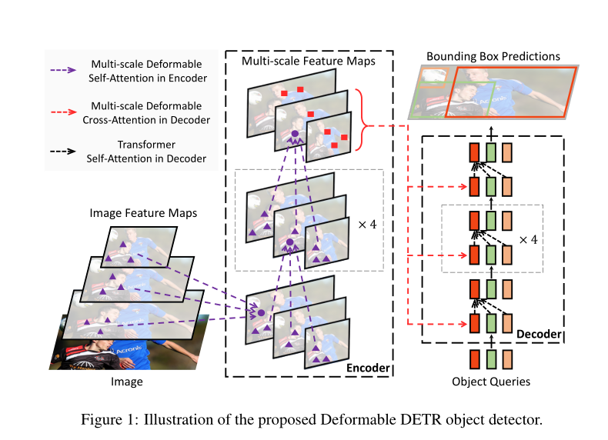

Slide 5
贡献总结
Deformable DETR is an end-to-end object detector, which is efficient and fast-converging. It enables us to explore more interesting and practical variants of end-to-end object detectors. At the core of Deformable DETR are the (multi-scale) deformable attention modules, which is an efficient attention mechanism in processing image feature maps. We hope our work opens up new possibilities in exploring end-to-end object detection.
Deformable DETR是一种高效、快速收敛的端到端目标检测方法。它使我们能够探索更有趣和更实用的端到端对象检测器。形变数据处理的核心是多尺度形变注意模块，它是处理图像特征图的一种有效的注意机制。我们希望我们的工作为探索端到端目标检测开辟了新的可能性

Slide 6
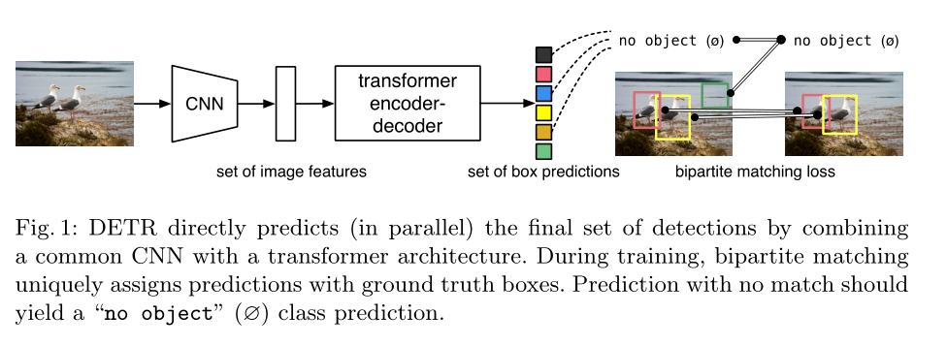
结构图

Slide 7
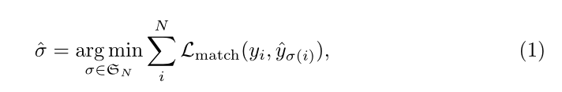


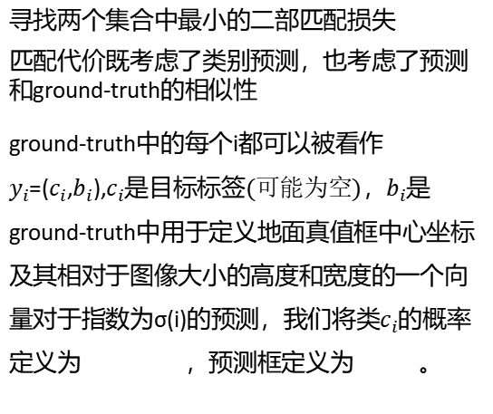
目标检测集预测损失 Object detection set prediction loss
DETR infers a fixed-size set of N predictions, in a single pass through the decoder, where N is set to be significantly larger than the typical number of objects in an image. One of the main difficulties of training is to score predicted objects (class, position, size) with respect to the ground truth. Our loss produces an optimal bipartite matching between predicted and ground truth objects, and then optimize object-specific (bounding box) losses. Let us denote by y the ground truth set of objects, and ˆy = {ˆyi}Ni=1 the set of N predictions. Assuming N is larger than the number of objects in the image, we consider y also as a set of size N padded with ∅ (no object). To find a bipartite matching between these two sets we search for a permutation of N elements σ ∈ SN with the lowest cost:
寻找两个集合中最小的二部匹配损失
匹配代价既考虑了类别预测，也考虑了预测和ground-truth的相似性
ground-truth中的每个i都可以被看作$y_{i}$=($c_{i}$,$b_{i}$),$c_{i}是目标标签(可能为空)$，$b_{i}$是ground-truth中用于定义地面真值框中心坐标及其相对于图像大小的高度和宽度的一个向量对于指数为σ(i)的预测，我们将类$c_{i}$的概率定义为 ，预测框定义为 。
Q
K
K
V
V

Slide 8


匈牙利的损失 （包含BBOX损失） Hungarian loss（Bounding box los）
This procedure of finding matching plays the same role as the heuristic assignment rules used to match proposal [37] or anchors [22] to ground truth objects in modern detectors. The main difference is that we need to find one-to-one matching for direct set prediction without duplicates.The second step is to compute the loss function, the Hungarian loss for all pairs matched in the previous step. We define the loss similarly to the losses of common object detectors, i.e. a linear combination of a negative log-likelihood for class prediction and a box loss defined later:
进行完前一步之后，计算损失函数
ˆσ是在第一步（1）中计算的最优分配，
L1损失可能产生损失相对扩大，这里使用了L1损失和iou损失的相对组合，其中λiou，λL1∈ R是超参数

Slide 9
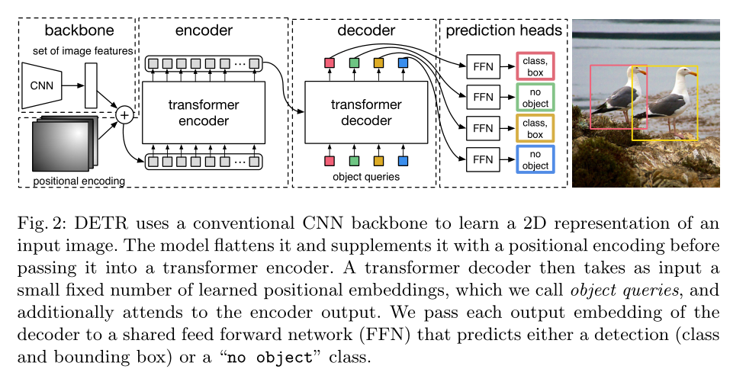
DETR结构

Slide 10
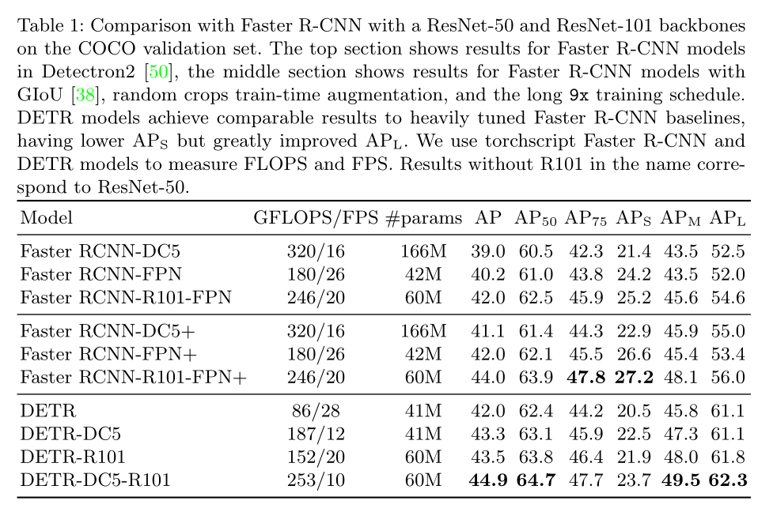
实验

Slide 11
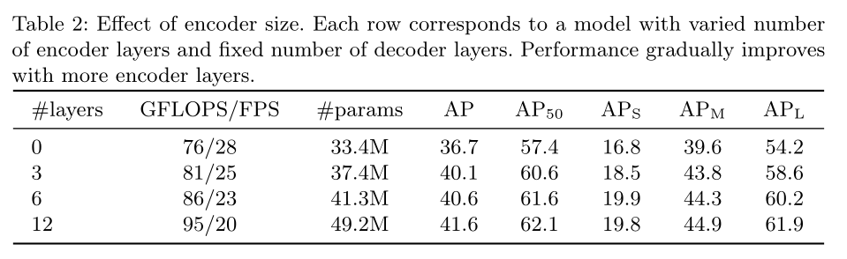

Slide 12
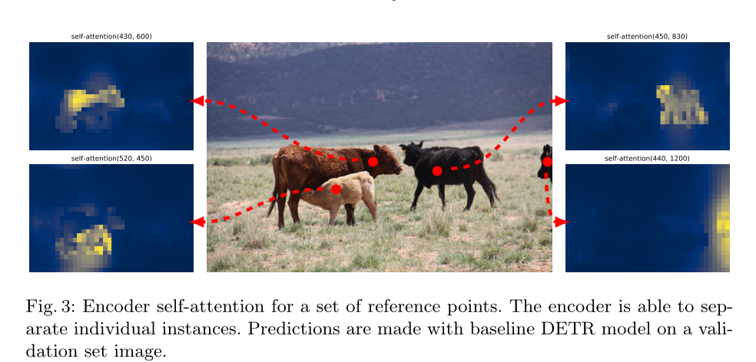

Slide 13
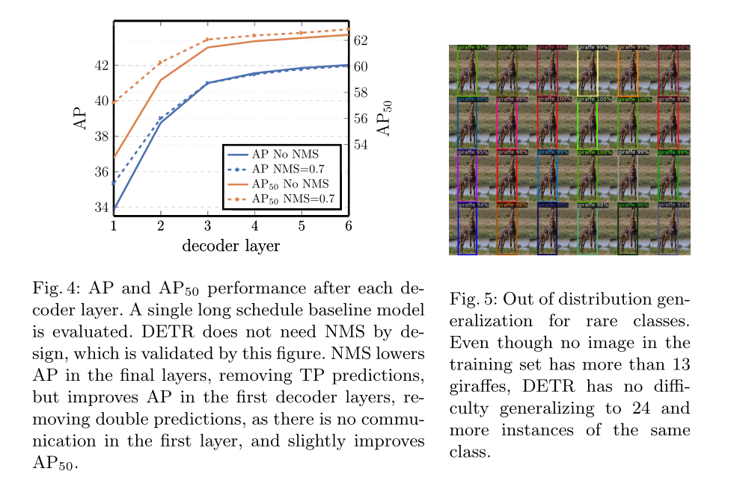

Slide 14
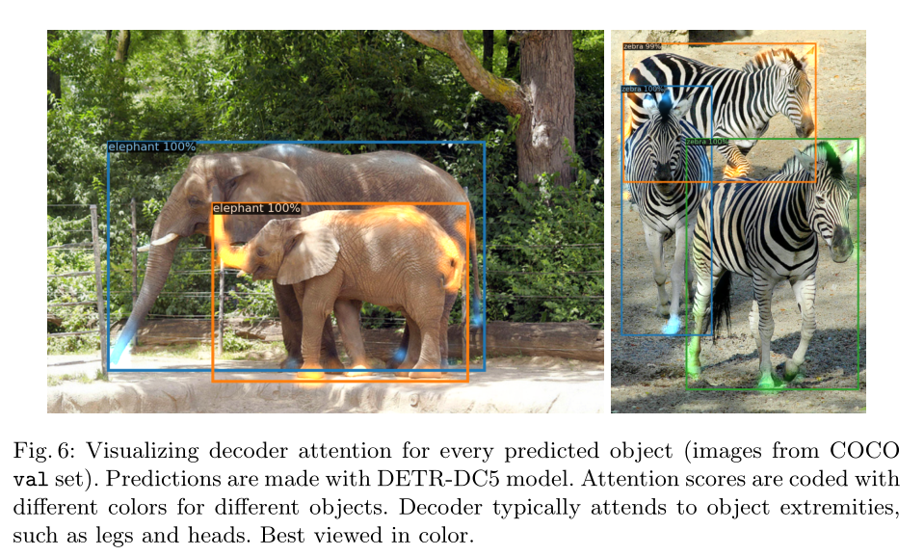

Slide 15
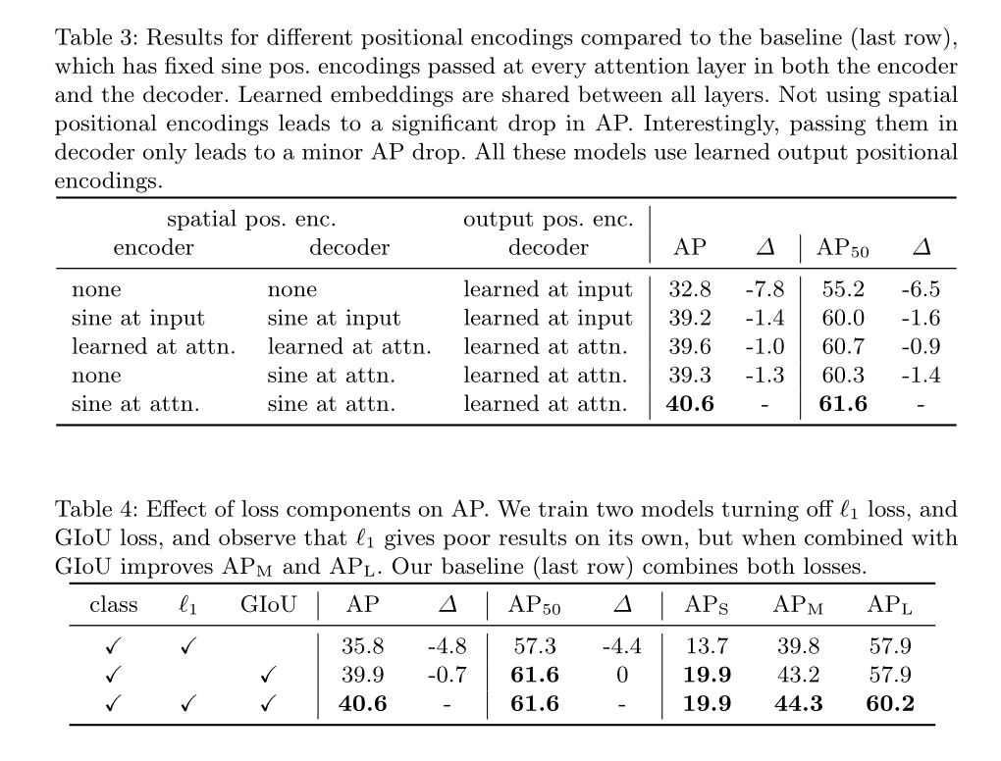

Slide 16
